Slide 1
Machine Learning
Chapter 3
DECISION TREE LEARNING
Dr. T. ADILAKSHMI

Slide 2
Introduction
Decision tree learning is a method for approximating discrete-valued target functions, in which the learned function is represented by a decision tree.
Learned trees can also be re-represented as sets of if-then rules to improve human readability

Slide 3
DECISION TREE REPRESENTATION
Decision trees classify instances by sorting them down the tree from the root to some leaf node, which provides the classification of the instance.
Each node in the tree specifies a test of some attribute of the instance, and each branch descending from that node corresponds to one of the possible values for this attribute.
An instance is classified by starting at the root node of the tree, testing the attribute specified by this node, then moving down the tree branch corresponding to the value of the attribute in the given example.
This process is then repeated for the subtree rooted at the new node.

Slide 4
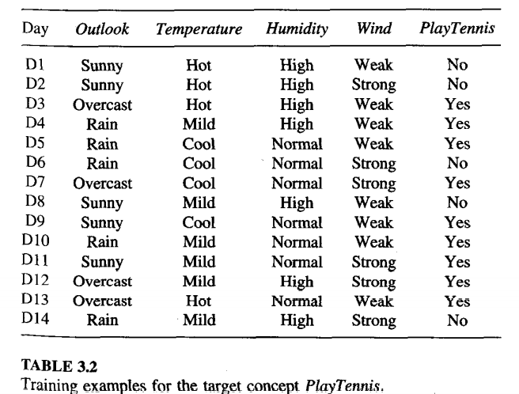
An Illustrative Example
To illustrate the operation of ID3, consider the learning task represented by the training examples of Table 3.2. Here the target attribute PlayTennis, which can have values yes or no for different Saturday mornings, is to be predicted based on other attributes of the morning in question.

Slide 5
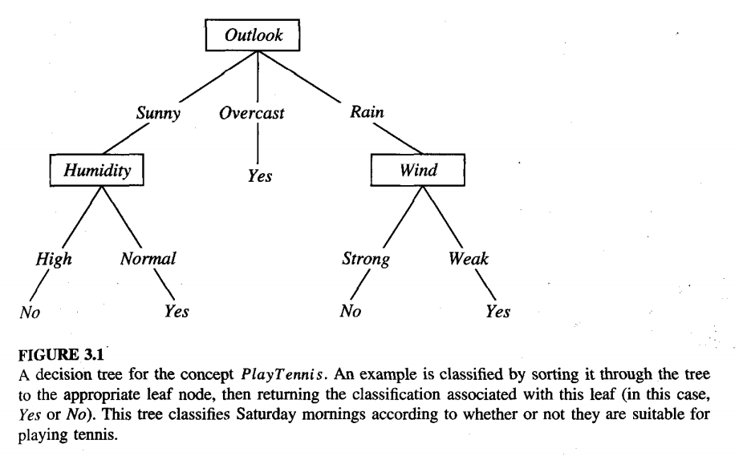
Figure 3.1 illustrates a typical learned decision tree.

Slide 6
This decision tree classifies Saturday mornings according to whether they are suitable for playing tennis.
For example, the instance
(Outlook = Sunny, Temperature = Hot, Humidity = High, Wind = Strong)
would be sorted down the leftmost branch of this decision tree and would therefore be classified as a negative instance, the tree predicts that PlayTennis = no
In general, decision trees represent a disjunction of conjunctions of constraints on the attribute values of instances.
Each path from the tree root to a leaf corresponds to a conjunction of attribute tests, and the tree itself to a disjunction of these conjunctions.

Slide 7
For example, the decision tree shown in Figure 3.1 corresponds to the expression
(Outlook = Sunny Λ Humidity = Normal)
V (Outlook = Overcast)
v (Outlook = Rain Λ Wind = Weak)

Slide 8
APPROPRIATE PROBLEMS FOR DECISION TREE LEARNING
Decision tree learning is generally best suited to problems with the following characteristics :
Instances are represented by attribute-value pairs. Instances are described by a fixed set of attributes and their values. Each attribute takes on disjoint possible values (e.g., Hot, Mild, Cold)
The target function has discrete output values. The decision tree assigns a boolean classification (e.g., yes or no) to each example. Decision tree methods extend to learning functions with more than two possible output values.
Disjunctive descriptions may be required. decision trees represent disjunctive expressions.
The training data may contain errors. Decision tree learning methods are robust to errors, both errors in classifications of the training examples and errors in the attribute values that describe these examples
The training data may contain missing attribute values. Decision tree methods can be used even when some training examples have unknown values

Slide 9
An Illustrative Example
To illustrate the operation of ID3, consider the learning task represented by the training examples of Table 3.2. Here the target attribute PlayTennis, which can have values yes or no for different Saturday mornings, is to be predicted based on other attributes of the morning in question.

Slide 10
Applications
Decision tree learning has therefore been applied to problems such as learning to classify medical patients by their disease, equipment malfunctions by their cause, and loan applicants by their likelihood of defaulting on payments.
Problems in which the task is to classify examples into one of a discrete set of possible categories, are often referred to as classification problems

Slide 11
THE BASIC DECISION TREE LEARNING ALGORITHM
algorithm, ID3, learns decision trees by constructing them top-down
“which attribute should be tested at the root of the tree?”
each instance attribute is evaluated using a statistical test to determine how well it alone classifies the training examples.
The best attribute is selected and used as the test at the root node of the tree.
A descendant of the root node is then created for each possible value of this attribute, and the training examples are sorted to the appropriate descendant node
The entire process is then repeated using the training examples associated with each descendant node to select the best attribute to test at that point in the tree.

Slide 12
Which Attribute Is the Best Classifier?
We would like to select the attribute that is most useful for classifying examples.
What is a good quantitative measure of the worth of an attribute?
We will define a statistical property, called information gain, that measures how well a given attribute separates the training examples according to their target classification

Slide 13

ENTROPY MEASURES HOMOGENEITY OF EXAMPLES
Measure used in information theory, called entropy, that characterizes the (im)purity of an arbitrary collection of examples.
Given a collection S, containing positive and negative examples of some target concept, the entropy of S is

Slide 14

where p+ is the proportion of positive examples in S and p- is the proportion of negative examples in S.
In all calculations involving entropy we define 0log0 to be 0.
To illustrate, suppose S is a collection of 14 examples of some boolean concept, including 9 positive and 5 negative examples. we adopt the notation [9+, 5-] to summarize such a sample of data.
Then the entropy of S relative to this boolean classification is
For example, if all members are positive (p+ = I), then p- is 0, and Entropy(S) = -1 . log2(1) - 0 . log2 0 = -1 . 0 - 0 . log2 0 = 0.
Entropy is 1 when the collection contains an equal number of positive and negative examples.
If the collection contains unequal numbers of positive and negative examples, the entropy is between 0 and 1.

Slide 15
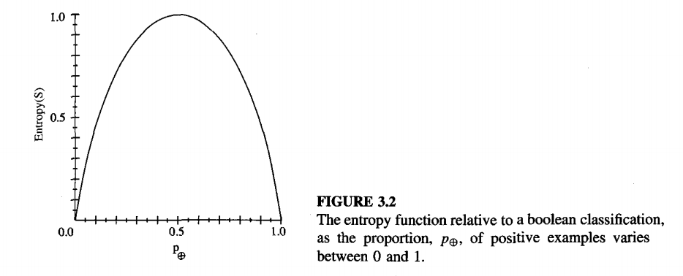

Slide 16
One interpretation of entropy from information theory is that it specifies the minimum number of bits of information needed to encode the classification of an arbitrary member of S
For example, if p+ is 1, the receiver knows the drawn example will be positive, so no message need be sent, and the entropy is zero.
On the other hand, if p+ is 0.5, one bit is required to indicate whether the drawn example is positive or negative.
If p+ is 0.8, then a collection of messages can be encoded using on average less than 1 bit per message by assigning shorter codes to collections of positive examples and longer codes to less likely negative examples.

Slide 17
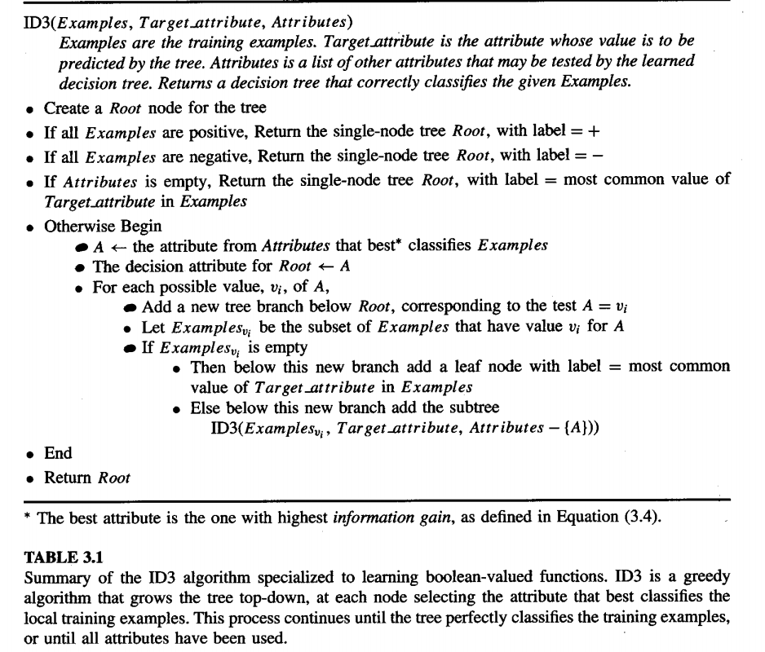

Slide 18

More generally, if the target attribute can take on c different values, then the entropy of S relative to this c-wise classification
where pi is the proportion of S belonging to class i.
the logarithm is still base 2 because entropy is a measure of the expected encoding length measured in bits.
if the target attribute can take on c possible values, the entropy can be as large as log₂ c.

Slide 19
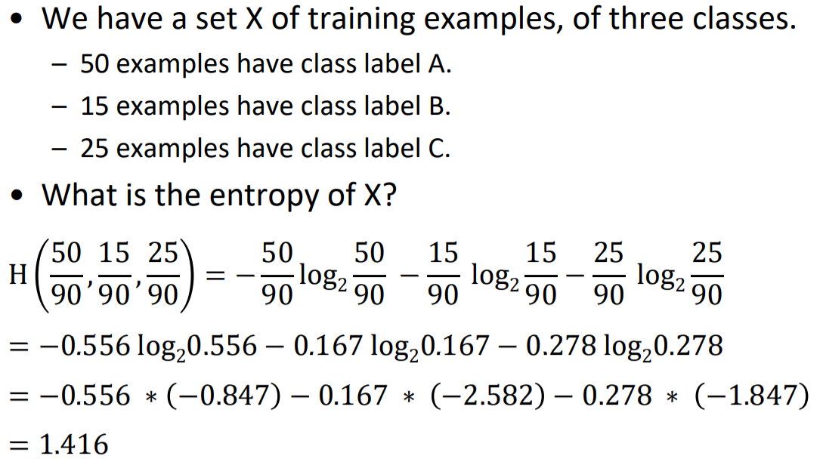

Slide 20
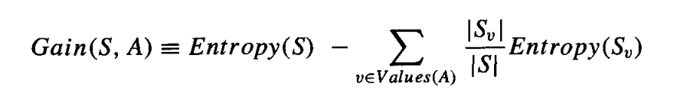
INFORMATION GAIN MEASURES THE EXPECTED REDUCTION IN ENTROPY
Given entropy as a measure of the impurity in a collection of training examples, we can define a measure of the effectiveness of an attribute in classifying the training data.
The measure we will use, called information gain, is simply the expected reduction in entropy caused by partitioning the examples according to this attribute.
More precisely, the information gain, Gain(S, A) of an attribute A, relative to a collection of examples S, is defined as

Slide 21
An Illustrative Example
To illustrate the operation of ID3, consider the learning task represented by the training examples of Table 3.2. Here the target attribute PlayTennis, which can have values yes or no for different Saturday mornings, is to be predicted based on other attributes of the morning in question.

Slide 22
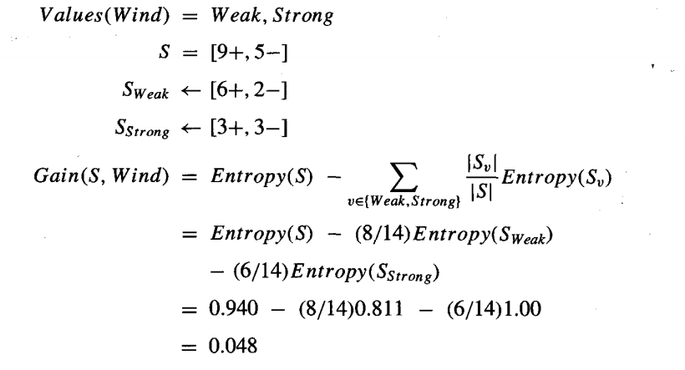
For example, suppose S is a collection of training-example days described by attributes including Wind, which can have the values Weak or Strong.
As before, assume S is a collection containing 14 examples, [9+, 5-]. Of these 14 examples, suppose 6 of the positive and 2 of the negative examples have Wind = Weak, and the remainder have Wind = Strong.
The information gain due to sorting the original 14 examples by the attribute Wind may then be calculated as

Slide 23
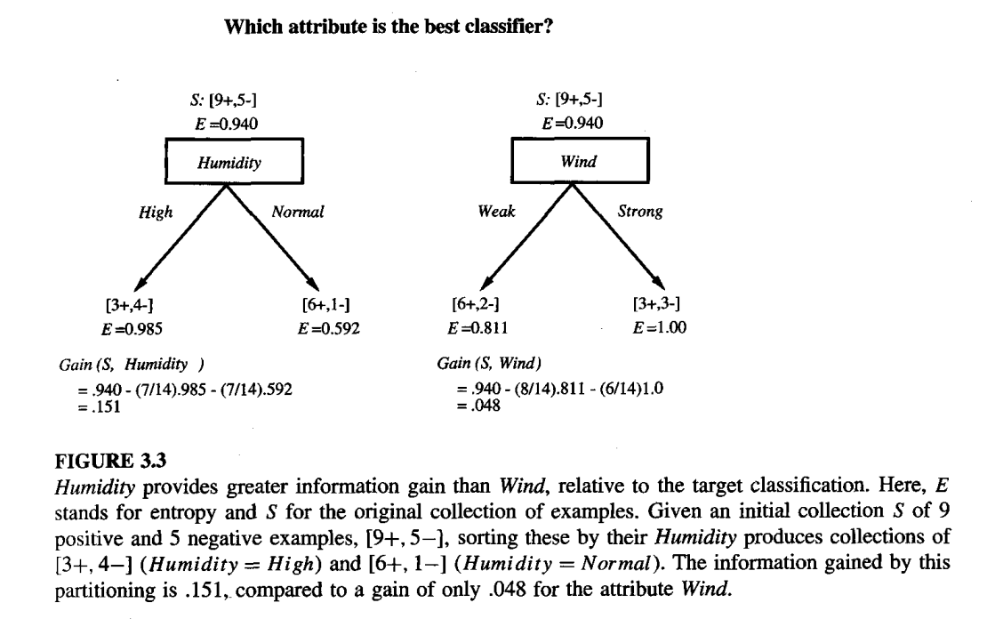

Slide 24
An Illustrative Example
To illustrate the operation of ID3, consider the learning task represented by the training examples of Table 3.2. Here the target attribute PlayTennis, which can have values yes or no for different Saturday mornings, is to be predicted based on other attributes of the morning in question.

Slide 25
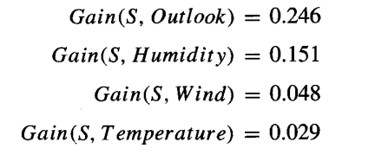
Consider the first step through the algorithm, in which the topmost node of the decision tree is created. Which attribute should be tested first in the tree? ID3 determines the information gain for each candidate attribute (i.e., Outlook, Temperature, Humidity, and Wind), then selects the one with highest information gain. The computation of information gain for two of these attributes is shown in Figure 3.3. The information gain values for all four attributes are
According to the information gain measure, the Outlook attribute provides the best prediction of the target attribute, PlayTennis, over the training examples. Therefore, Outlook is selected as the decision attribute for the root node, and branches are created below the root for each of its possible values (i.e., Sunny, Overcast, and Rain).

Slide 26
The process of selecting a new attribute and partitioning the training examples is now repeated for each non-terminal descendant node, this time using only the training examples associated with that node.
This process continues for each new leaf node until either of two conditions is met:
(1) every attribute has already been included along this path through the tree, or
(2) the training examples associated with this leaf node all have the same target attribute value (i.e., their entropy is zero).

Slide 27
An Illustrative Example
To illustrate the operation of ID3, consider the learning task represented by the training examples of Table 3.2. Here the target attribute PlayTennis, which can have values yes or no for different Saturday mornings, is to be predicted based on other attributes of the morning in question.

Slide 28
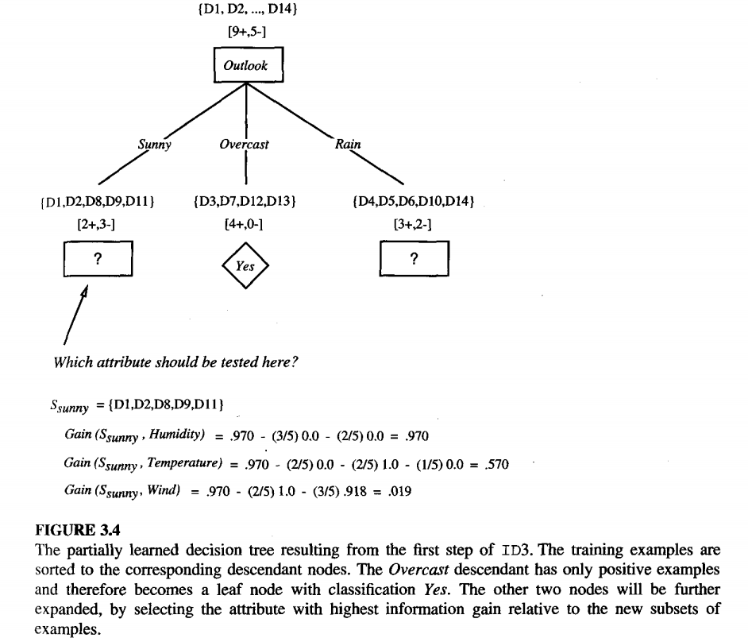

Slide 29
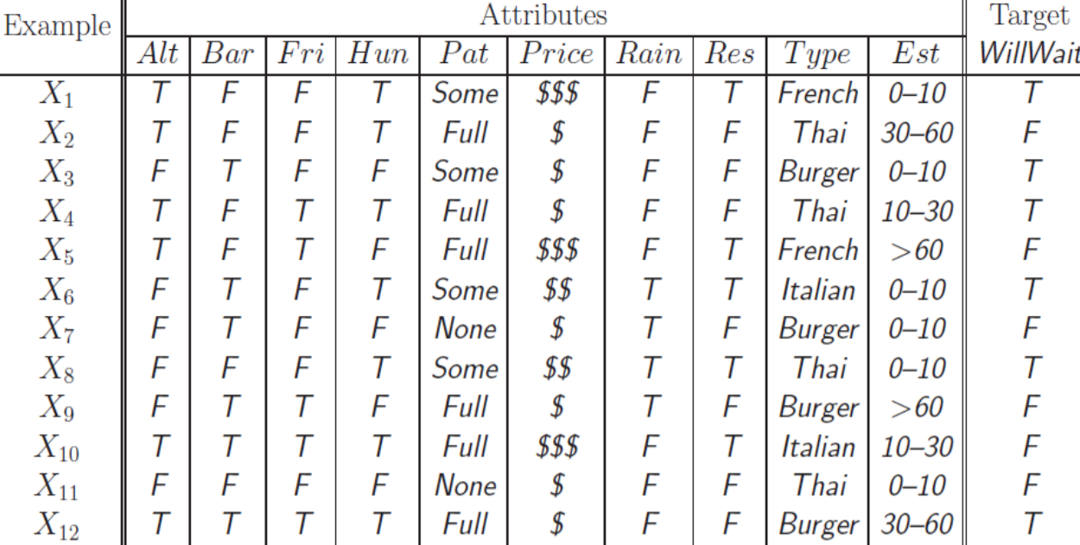
Exapmple 1

Slide 30
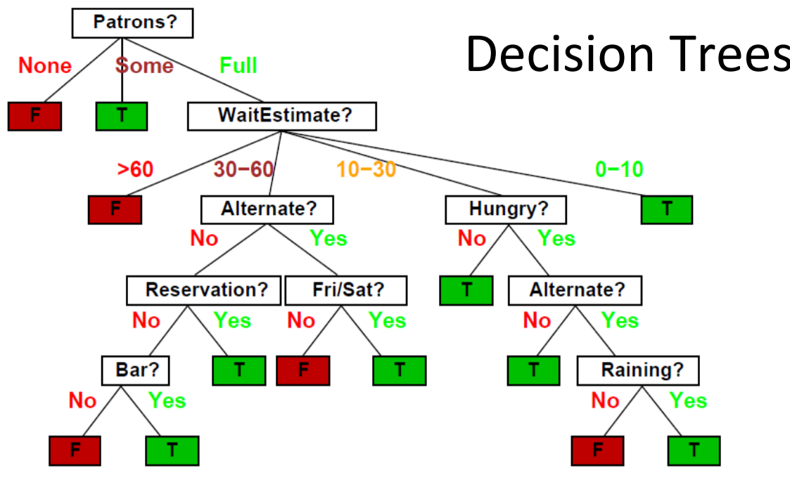
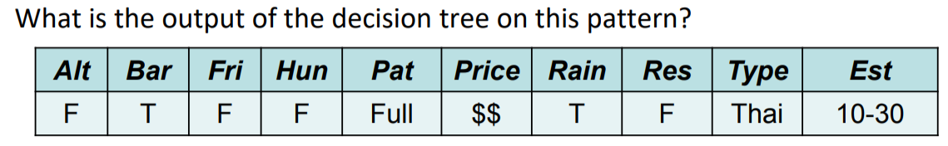

Slide 31
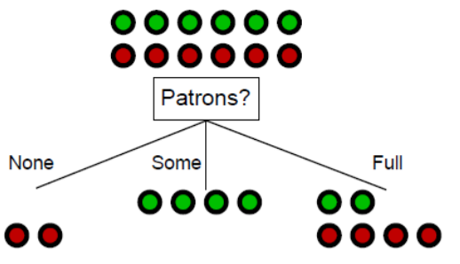
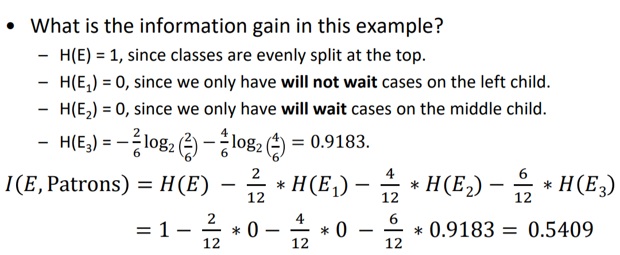

Slide 32
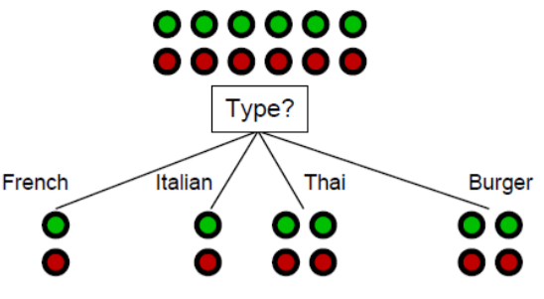
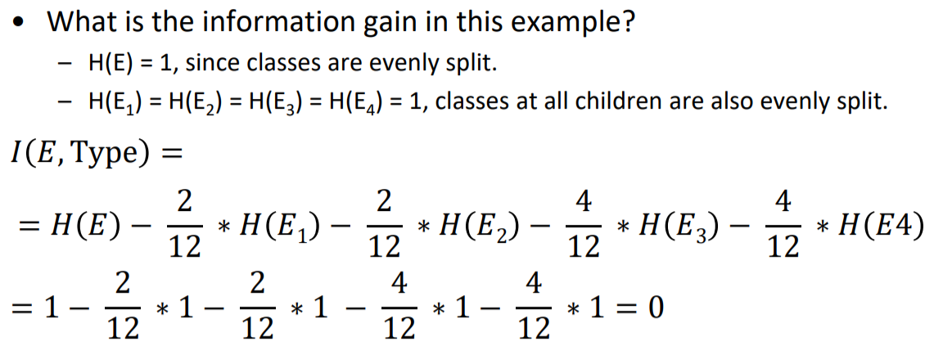

Slide 33
HYPOTHESIS SPACE SEARCH IN DECISION TREE LEARNING
As with other inductive learning methods, ID3 can be characterized as searching a space of hypotheses for one that fits the training examples.
The hypothesis space searched by ID3 is the set of possible decision trees.
ID3 performs hill-climbing search through this hypothesis space, beginning with the empty tree, then considering progressively more elaborate hypotheses in search of a decision tree that correctly classifies the training data.
The evaluation function that guides this hill-climbing search is the information gain measure. This search is depicted in Figure 3.5.

Slide 34
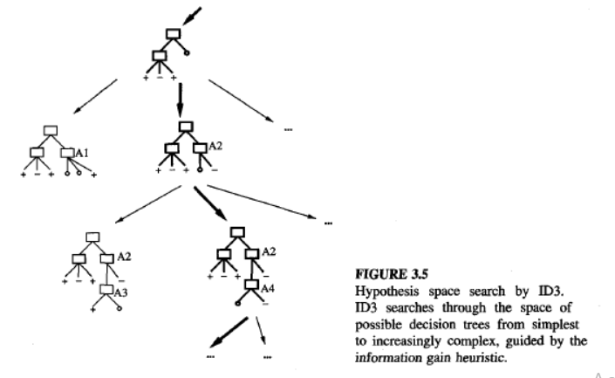

Slide 35
Capabilities and Limitations of ID3
ID3 maintains only a single current hypothesis as it searches through the space of decision trees. This contrasts, with the earlier version space candidate Elimination method, which maintains the set of all hypotheses consistent with the available training examples.
By determining only a single hypothesis, ID3 loses the capabilities that follow from explicitly representing all consistent hypotheses. It does not have the ability to determine how many alternative decision trees are consistent with the available training data.

Slide 36
ID3 in its pure form performs no backtracking in its search. Once it, selects an attribute to test at a particular level in the tree, it never backtracks to reconsider this choice. Therefore, it is susceptible to the usual risks of hill-climbing search without backtracking, converging to locally optimal solutions that are not globally optimal.
ID3 uses all training examples at each step in the search to make statistically based decisions regarding how to refine its current hypothesis. This contrasts with methods that make decisions incrementally, based on individual training examples (e.g., FIND-S or CANDIDATE-ELIMINATOION ).
One advantage of using statistical properties of all the examples (e.g., information gain) is that the resulting search is much less sensitive to errors in individual training examples.
ID3 can be easily extended to handle noisy training data by modifying its termination criterion to accept hypotheses that imperfectly fit the training data

Slide 37
ISSUES IN DECISION TREE LEARNING
1) Avoiding Overfitting the Data
The algorithm grows each branch of the tree just deeply enough to perfectly classify the training examples. It can lead to difficulties when there is noise in the data, or when the number of training examples is too small to produce a representative sample of the true target function.
In either of these cases, algorithm can produce trees that overfit the training examples.
We say that a hypothesis overfits the training examples if some other hypothesis that fits the training examples less well actually performs better over the entire distribution of instances (including instances beyond the training set)

Slide 38
The horizontal axis of this plot indicates the total number of nodes in the decision tree, as the tree is being constructed. The vertical axis indicates the accuracy of predictions made by the tree. The solid line shows the accuracy of the decision tree over the training examples, whereas the broken line shows accuracy measured over an independent set of test examples that are not included in the training set. The accuracy of the tree over the training examples increases monotonically as the tree is grown. However, the accuracy measured over the independent test examples first increases, then decreases. As can be seen, once the tree size exceeds approximately 25 nodes, further elaboration of the tree decreases its accuracy over the test examples despite increasing its accuracy on the training examples.

Slide 39
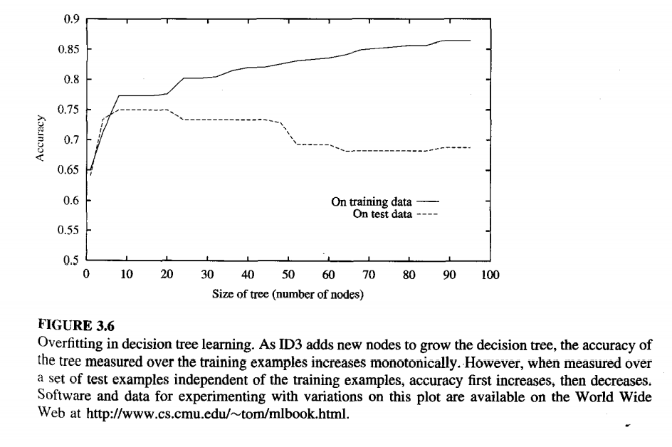

Slide 40
There are several approaches to avoiding overfitting in decision tree learning. These can be grouped into two classes:
approaches that stop growing the tree earlier, before it reaches the point where it perfectly classifies the training data
approaches that allow the tree to overfit the data, and then post-prune the tree.
the second approach of post-pruning overfit trees has been found to be more successful in practice.

Slide 41
Criterion to be used to determine the correct final tree size
Use a separate set of examples, distinct from the training examples, to evaluate the utility of post-pruning nodes from the tree
Use all the available data for training, apply a statistical test to estimate whether expanding (or pruning) a particular node is likely to produce an improvement beyond the training set.
halting growth of the tree when encoding size is minimized. This approach, based on a heuristic called the Minimum Description Length principle

Slide 42
validation
The available data are separated into two sets of examples: a training set, which is used to form the learned hypothesis,
and a separate validation set, which is used to evaluate the accuracy of this hypothesis over subsequent data
One common heuristic is to withhold one-third of the available examples for the validation set, using the other two-thirds for training.

Slide 43
REDUCED ERROR PRUNING
consider each of the decision nodes in the tree to be candidates for pruning.
Pruning a decision node consists of removing the subtree rooted at that node, making it a leaf node, and assigning it the most common classification of the training examples affiliated with that node.
Nodes are removed only if the resulting pruned tree performs no worse than-the original over the validation set.
Nodes are pruned iteratively, always choosing the node whose removal increases the decision tree accuracy over the validation set.
Pruning of nodes continues until further pruning is harmful .

Slide 44
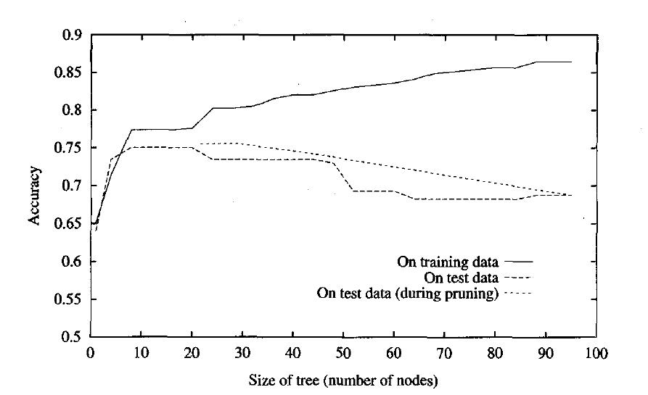

Slide 45
RULE POST PRUNING
Post-pruning involves the following steps:
Infer the decision tree from the training set, growing the tree until the training data is fit as well as possible and allowing overfitting to occur.
Convert the learned tree into an equivalent set of rules by creating one rule for each path from the root node to a leaf node.
Prune each rule by removing any preconditions that result in improving its estimated accuracy.
Sort the pruned rules by their estimated accuracy, and consider them in this sequence when classifying subsequent instances.
Each attribute test along the path from the root to the leaf becomes a rule antecedent (precondition) and the classification at the leaf node becomes the rule consequent (postcondition).
Figure 3.1 is translated into the rule
IF (Outlook = Sunny) Λ (Humidity = High)
THEN PlayTennis = No

Slide 46
2)Incorporating Continuous-Valued Attributes
Our initial definition of ID3 is restricted to attributes that take on a discrete set of values.
First, the target attribute whose value is predicted by the learned tree must be discrete valued.
Second, the attributes tested in the decision nodes of the tree must also be discrete valued.
This second restriction can easily be removed so that continuous-valued decision attributes can be incorporated into the learned tree.
This can be accomplished by dynamically defining new discrete valued attributes that partition the continuous attribute value into a discrete set of intervals.
for an attribute A that is continuous-valued, the algorithm can dynamically create a new boolean attribute A, that is true if A < c and false otherwise. The only question is how to select the best value for the threshold c.

Slide 47
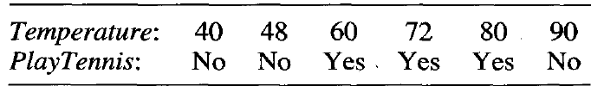
In the current example, there are two candidate thresholds, corresponding to the values of Temperature at which the value of PlayTennis changes: (48 + 60)/2, and (80 + 90)/2.
The information gain can then be computed for each of the candidate attributes, Temperature>54,and Temperature>85, and the best can be selected (Temperature>54).

Slide 48
Alternative Measures for Selecting Attributes:
There is a natural bias in the information gain measure that favors attributes with many values over those with few values.
consider the attribute Date, which has a very large number of possible values. If we were to add this attribute date to our enjoysport example, it would have the highest information gain of any of the attributes.
This is because Date alone perfectly predicts the target attribute over the training data. Thus, it would be selected as the decision attribute for the root node of the tree and lead to a tree of depth one, which perfectly classifies the training data.
This decision tree would fare poorly on subsequent examples, because it is not a useful predictor despite the fact that it perfectly separates the training data.

Slide 49
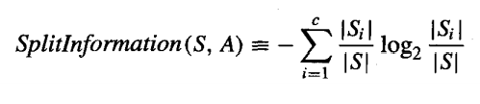
One alternative measure that has been used successfully is the gain ratio
The gain ratio measure penalizes attributes such as Date by incorporating a term, called split information, that is sensitive to how broadly and uniformly the attribute splits the data:
where S₁ through S_{c} are the c subsets of examples resulting from partitioning S by the c-valued attribute A. Split information is actually the entropy of S with respect to the values of attribute A.

Slide 50

The Gain Ratio measure is defined in terms of Gain measure, as well as this Split lnformation, as follows
the Split lnformation term discourages the selection of attributes with many uniformly distributed values.
For example, consider a collection of n examples that are completely separated by attribute A (e.g., Date). In this case, the Split lnformation value will be log₂ n.
In contrast, a boolean attribute B that splits the same n examples exactly in half will have Split lnfomzation of 1. If attributes A and B produce the same information gain, then clearly B will score higher according to the Gain Ratio measure.

Slide 51
Handling Training Examples with Missing Attribute Values
In certain cases, the available data may be missing values for some attributes.
in a medical domain in which we wish to predict patient outcome based on various laboratory tests, it may be that the lab test Blood-Test-Result is available only for a subset of the patients.
In such cases, it is common to estimate the missing attribute value based on other examples for which this attribute has a known value.
One strategy for dealing with the missing attribute value is to assign it the value that is most common among training examples at node n.
Alternatively, we might assign it the most common value among examples at node n that have the classification c(x).

Slide 52
Handling Attributes with Differing Costs
In some learning tasks the instance attributes may have associated costs.
For example, in learning to classify medical diseases we might describe patients In terms of attributes such as Temperature, Biopsy Result, Pulse, BloodTest Results, etc.
These attributes vary significantly in their costs, both in terms of monetary cost and cost to patient comfort.
In such tasks, we would prefer decision trees that use low-cost attributes where possible, relying on high-cost attributes only when needed to produce reliable classifications.

Slide 53


ID3 can be modified to take into account attribute costs by introducing a cost term into the attribute selection measure.
divide the gain by the cost of the attribute, so that lower-cost attributes would be preferred. While such cost-sensitive measures do not guarantee finding an optimal cost-sensitive decision tree.
Tan (1993) used
Nunez (1988) used
where w E [0, 1] is a constant that determines the relative importance of cost
versus information gain.

